Slide 1

Student Performance Analysis & Visualization
Explore key factors influencing student achievement. Understand demographics, academic performance, and comparative insights to drive informed educational decisions.
By: DataNinja Team (Afolabi, Branson and Eniola)

Slide 2
Introduction
Project Objective: Analyse student performance across demographics.
Deliver insights using Python visualizations and Power BI dashboards.
Tools: Python (Pandas, Seaborn), Power BI, Dataset: 1000 students

Slide 3










Demographic Landscape
Race/Ethnicity
Gender Distribution
Examine diverse ethnic group presence.
Analyze male vs. female representation.
Parental Education
Understand education level impact.
Test Prep Completion
Assess course participation rates.
Lunch Type
Compare standard vs. subsidized meals.

Slide 4

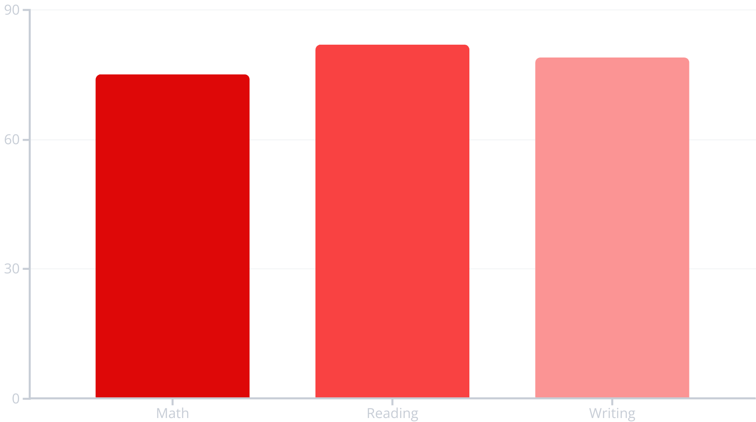
Academic Performance Overview
Key Metrics
Average scores by subject.
Score distribution insights.
Identify top/bottom performers.
These insights reveal overall academic strengths and areas needing improvement.

Slide 5
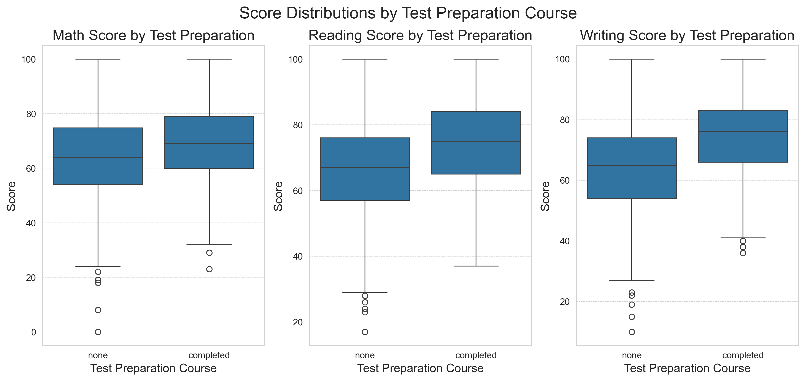
Python Visualizations
Box Plot: Scores by Gender – Highlights that female students outperform males in reading and writing, whereas male students achieve higher scores in math.

Slide 6
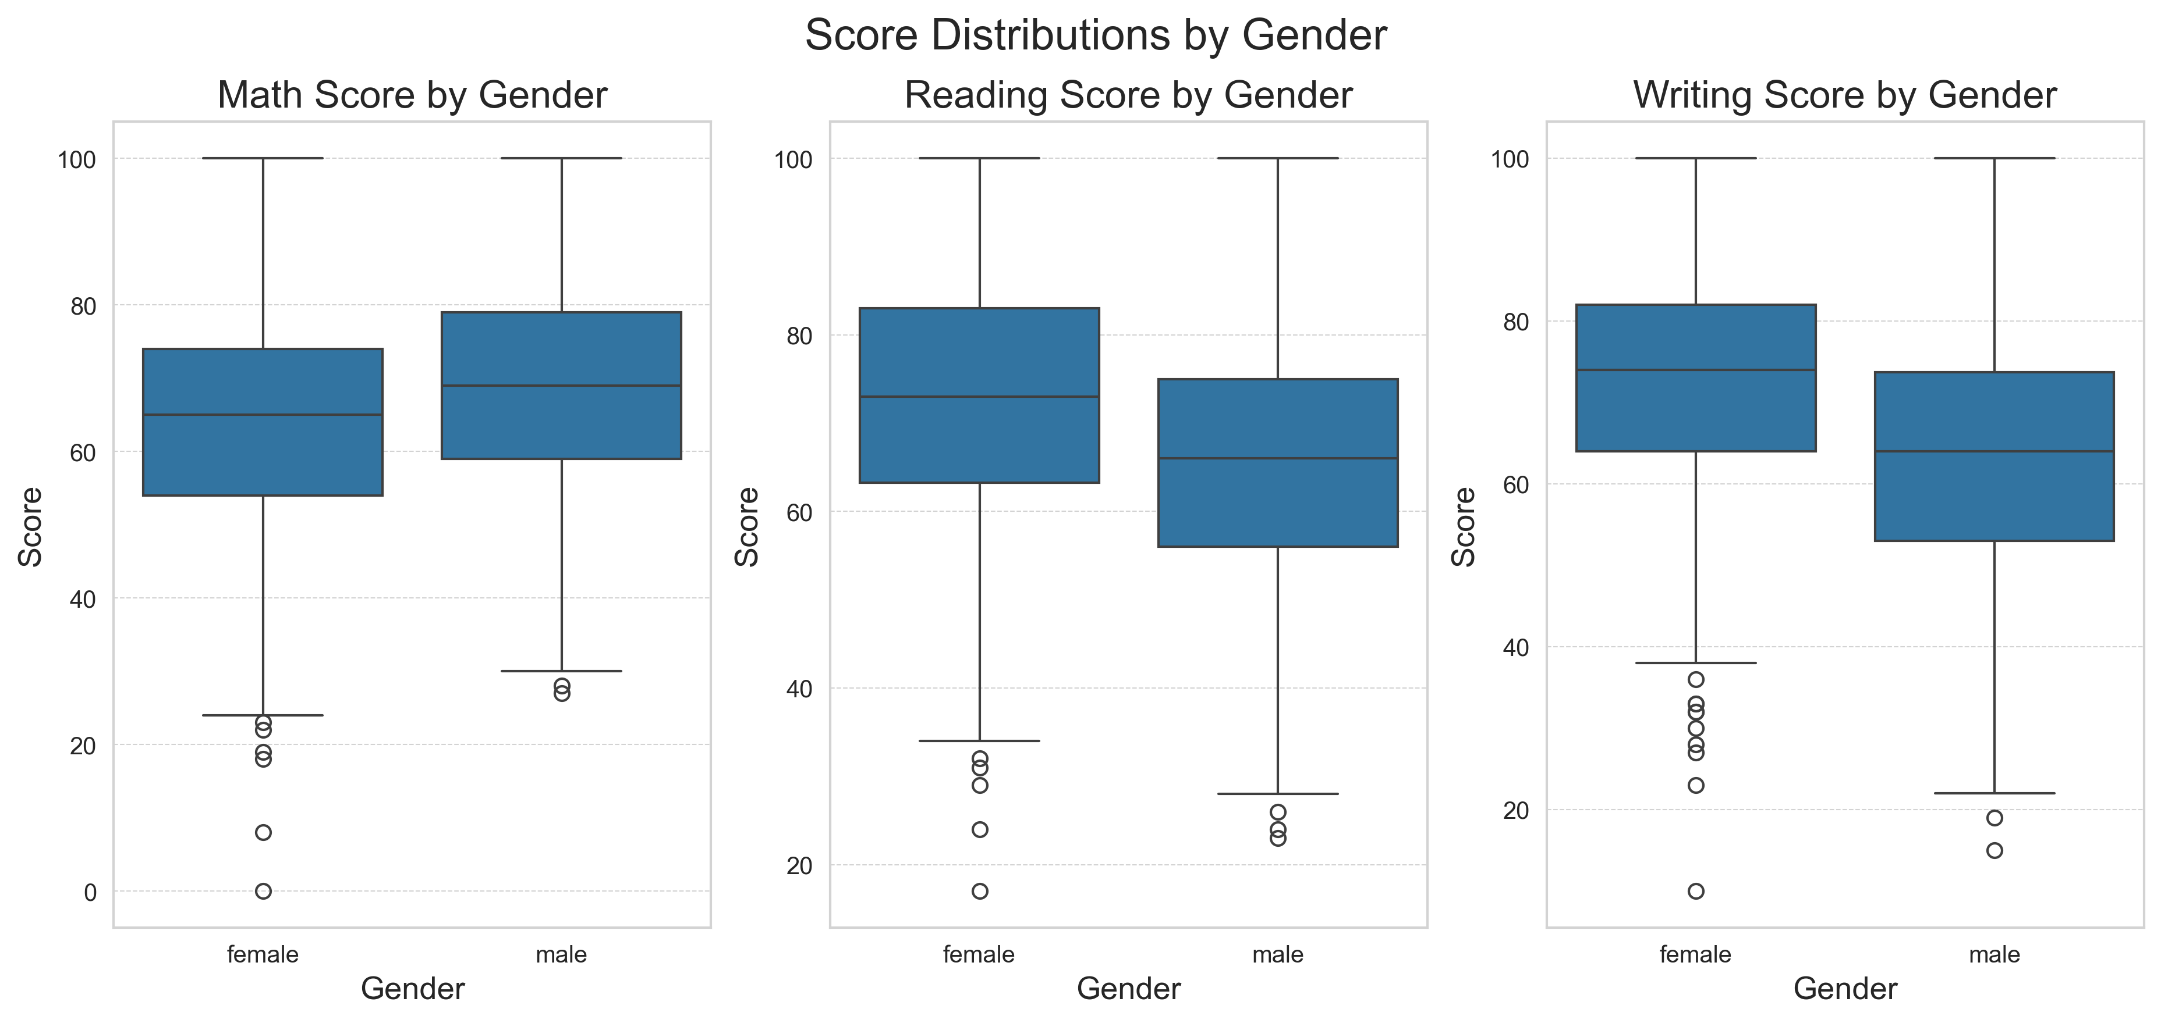
Python Visualizations
Box Plot: Scores by Gender – Illustrates that female students tend to perform better in reading and writing, while male students show stronger performance in math

Slide 7
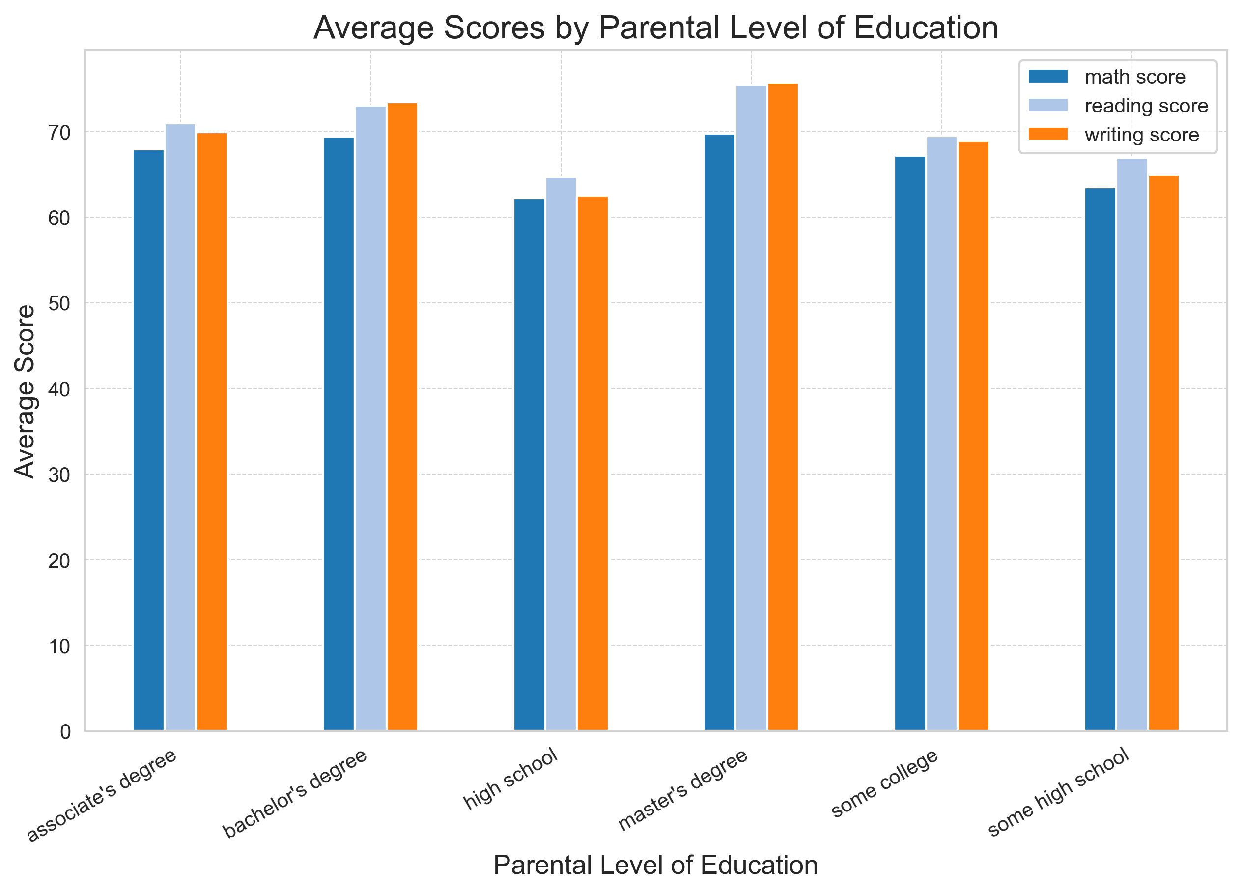
Python Visualizations
Bar Chart: Parental Education – Explains how parental education affected student performance.

Slide 8
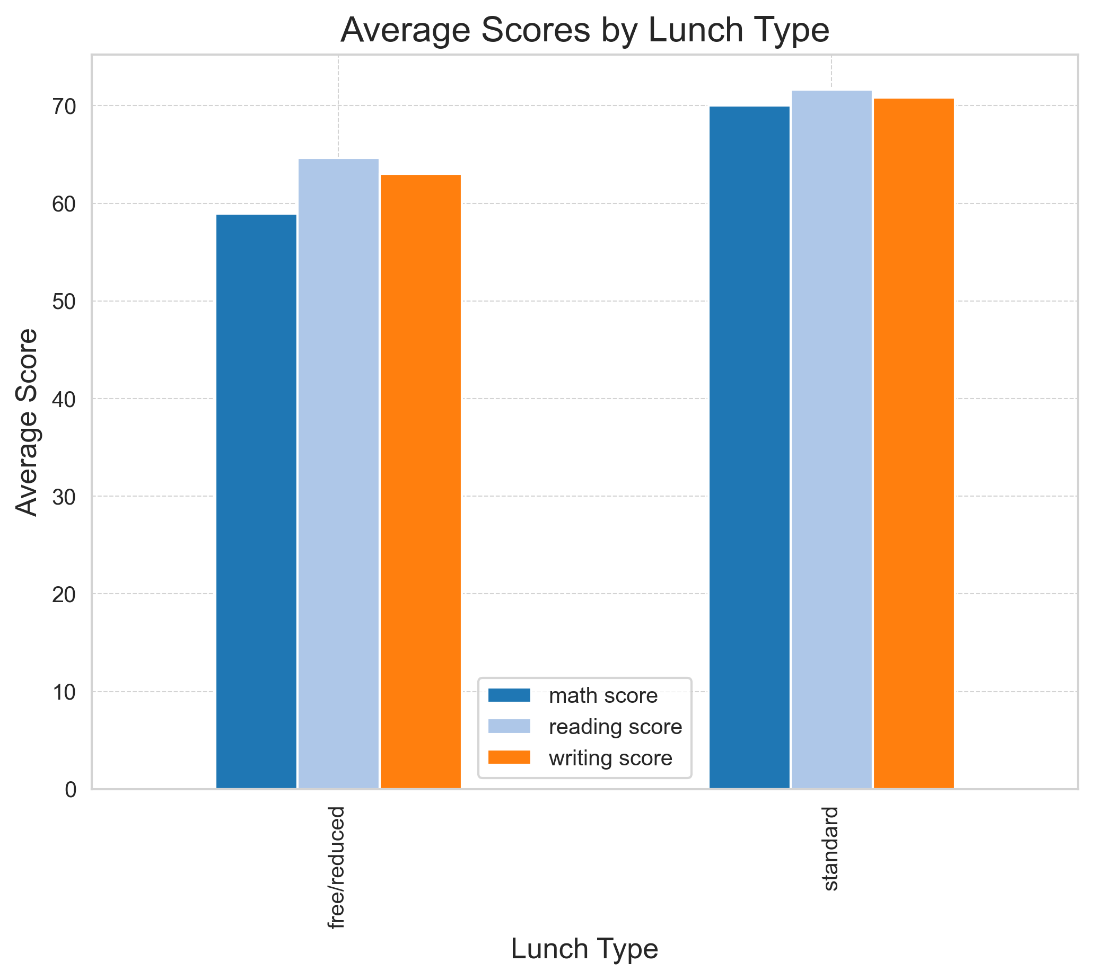
Python Visualizations
Bar Chart: Lunch Type – Shows that students receiving standard lunch consistently perform better than those on free or reduced lunch, indicating a link to socioeconomic status.

Slide 9
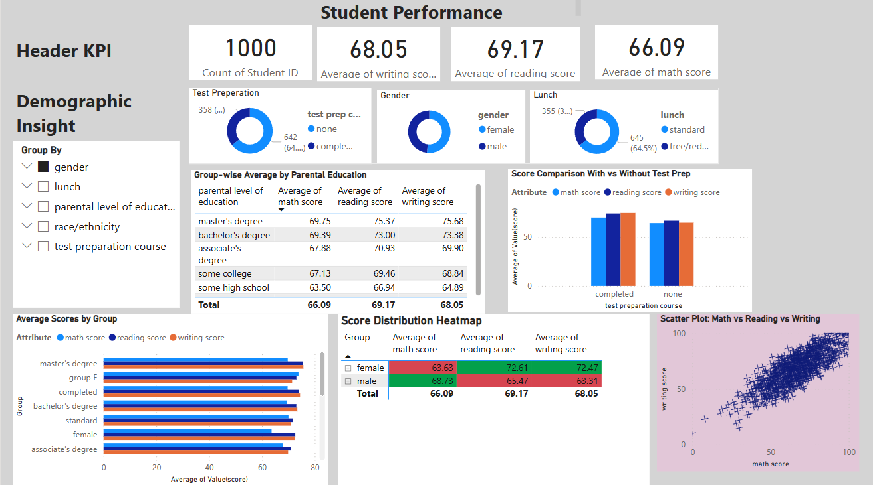
This interactive Power BI dashboard visualizes student performance across math, reading, and writing, with dynamic filters for gender, parental education, lunch status, and test preparation to uncover key demographic insights and performance trends

Slide 10


Outlier and Risk Analysis
Custom Visuals: Full control over plot styling with matplotlib and seaborn (e.g., Tableau 20 palette, themed styles). | Pre-built Visuals: Drag-and-drop creation of charts (bar, pie, donut, matrix, etc.)
Flexible Analysis: Boxplots, grouped bar charts, correlation heatmaps fully customized logic and layout. | Interactivity: Filter by gender, lunch type, parental education; dynamic cross-filtering
Static Outputs: Plots are exported as static .png images suitable for reports or documentation. | User-Friendly: Designed for non-programmers; GUI-based exploration
Key Use Case: Deep statistical insight Full control over data manipulation Ideal for automation and scripting | Key Use Case: Presentation-ready visuals Business stakeholders’ consumption Real-time filtering and slicing
Python
Power BI

Slide 11
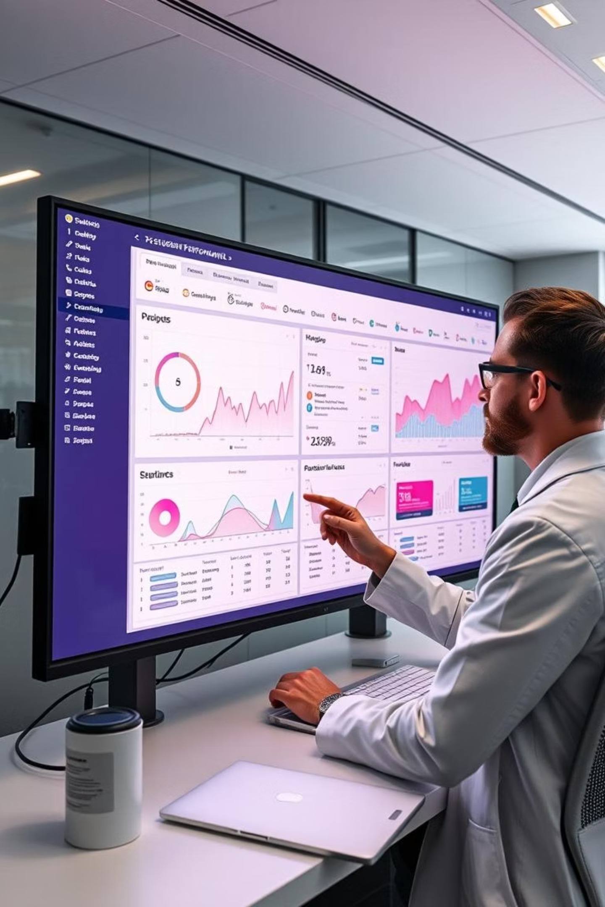



Next Steps and Dashboard Potential
Dynamic Filters
Slice data by demographics.
Group Comparison
Compare any two student groups.
Score Dashboards
Visual performance by variable.
Leverage interactive dashboards for continuous monitoring and data-driven educational strategies.

Slide 12
Recommendations & Future Work
📌 Recommendations for Educators & Policymakers
Focus Support on At-Risk Groups Use insights (e.g., lunch type, test prep course impact) to design targeted interventions.
Promote Test Preparation Programs Data shows improved scores for students who completed test prep—consider expanding access.
Engage Parents Leverage correlations with parental education to involve families in student progress.
🚀 Future Potential
Predictive Modeling Use Python to build machine learning models that predict student success based on early indicators.
Broader Datasets Integrate attendance, behavioral, and socio-economic data for deeper insights.
🔍 Next Steps in Analysis
Longitudinal Tracking Monitor student performance over time to evaluate the impact of policy changes.
Trend Analysis Identify long-term shifts in scores by demographic or support intervention.

Slide 13
THANK YOU

